Slide 1
EDU PREDICT TOOL​ PREDICTING ENROLLMENT TRENDS IN​ HIGHER EDUCATION IN THE USA

Slide 2

PROJECT DETAILS :
Project Title: EDU PREDICT TOOL
Project Team: 02
Project Advisor: Dr. Sula ​
MSDS Capstone – SP 25 DSCI 6051-07
Date of Presentation: 05-02-2025

Slide 3
EDU PREDICT TOOL​ PREDICTING ENROLLMENT TRENDS IN​ HIGHER EDUCATION IN THE USA
Objective: Forecast enrollment trends for international students in U.S. higher education institutions using machine learning.
Final Product: An interactive Power BI dashboard that visualizes scenario-based enrollment forecasts (Baseline, Optimistic, Pessimistic).
Key Features:
Integration of machine learning model outputs for data-driven predictions.
User interactivity with filters for region, academic level, and year range to explore trends dynamically.
Impact: Helps university administrators and policymakers make informed decisions for strategic academic planning and resource allocation.

Slide 4






MEET THE TEAM :
KRISHNA CHAITANYA VUTUKURU
(Machine Learning Engineer)
VENKATA NAGA SAI PRIYANKA BODDOJU
(Team Lead , Data Engineer)
SAI KRISHNA TURANGI
(Data Analyst)
SANTOSH KUMAR SALADI
(Machine Learning Engineer)
TEJA REDDY SOMA
(Dashboard Developer)
HARIKA SURAVARAPU
(Data Engineer)

Slide 5
PROBLEM STATEMENT:
The Core Challenge: University Enrollment Dynamics
Universities are struggling to predict and manage enrolment due to three major hurdles:
External Disruptions : Government policies, global events, and economic shifts disrupt international student flows.
Unstable Enrollment Trends : Rapid demographic changes and evolving student preferences make forecasting difficult.
Data Disconnection : Fragmented data systems result in incomplete analysis and reactive decision-making.
Notes:
Define the problem or opportunity that you are addressing. Include pictures, figures, and statistics to help the audience better conceptualize the problem or opportunity.
Specify who your users or customers are and what pain points they are experiencing.
For example: “Users complain that the student admissions department website is too slow and isn’t always available.”
Also, list any specific business requirements that you are addressing.
For example: “Improve the experience for users. The web application can be deployed to the AWS Cloud. The application must be highly available, scalable, load balanced, secure, and performant architecture that can support thousands of users.“
Note:
An above-bar overview succinctly defines the problem and opportunity statement. For example: “Customers with media files, such as retail companies, need an easy and cost-effective way to analyze photos and videos of their inventory.”
A below-bar overview is too verbose, technical, or not specific. For example: “The most common media files are .jpg and .mp4. Companies have media files of their inventory.”

Slide 6
TASK DEFINITION :
Input: Historical enrollment data, external influencing factors (e.g., policies, economic trends).
Processing: Machine learning models analyze data and predict future enrollment under Baseline, Optimistic, and Pessimistic scenarios.
Output: Interactive Power BI dashboard displaying scenario-based enrollment forecasts with user-friendly filters for region, academic level, and year range.
Real-World Problem Solved: Helps universities and policymakers make informed decisions about academic planning, resource allocation, and policy adjustments based on predictive insights.
Notes:
Define the problem or opportunity that you are addressing. Include pictures, figures, and statistics to help the audience better conceptualize the problem or opportunity.
Specify who your users or customers are and what pain points they are experiencing.
For example: “Users complain that the student admissions department website is too slow and isn’t always available.”
Also, list any specific business requirements that you are addressing.
For example: “Improve the experience for users. The web application can be deployed to the AWS Cloud. The application must be highly available, scalable, load balanced, secure, and performant architecture that can support thousands of users.“
Note:
An above-bar overview succinctly defines the problem and opportunity statement. For example: “Customers with media files, such as retail companies, need an easy and cost-effective way to analyze photos and videos of their inventory.”
A below-bar overview is too verbose, technical, or not specific. For example: “The most common media files are .jpg and .mp4. Companies have media files of their inventory.”

Slide 7
METHODOLOGY :
The problem of forecasting international student enrollment trends will be addressed using machine learning models trained on historical enrollment data. A data-driven approach is essential to capture patterns influenced by multiple factors such as demographics, academic levels, and external policies.
Machine learning enables scenario-based forecasting (Baseline, Optimistic, Pessimistic), allowing institutions to make informed decisions based on predicted trends. Traditional statistical methods may not capture complex, non-linear relationships in the data as effectively.
Notes:
Explain at a high level what you have built.
For example: “I built a web application for a company to host their blog.“
Talk about why you chose certain parts of the solutions and any tradeoffs that you made. Focus on how you designed the solutions and how you applied the AWS Well-Architected Framework as part of the process (AWS Well-Architected Framework: https://docs.aws.amazon.com/wellarchitected/latest/framework/welcome.html).
For example: “I configured load balancers and auto scaling to make the application highly available and reliable.”
Include the use cases that you are addressing. Think about who your users are and how they would want to interact with your solution to solve their problem.
For example: “Users can view, upload, edit, and delete blog posts. Administrators can approve blog posts.”
Talk about the use cases that you addressed as part of the minimum viable product (MVP) that you scoped and built.
Note:
An above-bar description is concise and includes the most important benefits. For example: “The solution allows customers to quickly upload, store, and search large catalogs of images and videos in Amazon S3.”
A below-bar description is too detailed or not specific. For example: “Our solution analyzes media files.”

Slide 8
CHALLENGES & DATA PHENOMENA :
Data Integration: Merging multiple CSV files with different structures.
Missing & Noisy Data: Handling gaps and inconsistencies in historical records.
Feature Selection: Identifying key predictors that influence enrollment trends.
External Factors: Accounting for sudden changes (e.g., policy shifts, economic conditions).

Slide 9
MODELLING APPROACH
Algorithm Selection & Trade-off’s :
Polynomial Regression Models relationships using higher-degree equations to capture non-linearity. Simple and interpretable but can overfit on complex trends.
Polynomial Regression Models relationships using higher-degree equations to capture non-linearity. Simple and interpretable but can overfit on complex trends.
XGBoost & CatBoost Powerful ML models that capture complex interactions and patterns. Highly accurate but require tuning and are resource-intensive.
ARIMA Designed for time-series forecasting with seasonal and trend components. Ideal for temporal data but assumes stationarity and can be sensitive to noise.

Slide 10
IMPLEMENTATION CHOICES :
Feature Engineering: Encoding categorical variables and normalizing numerical features.
Hyperparameter Tuning: Using techniques like Optuna to fine-tune models for optimal accuracy.
Deployment: Forecasts will be integrated into an interactive Power BI dashboard for easy access and decision-making.

Slide 11
DATASET DESCRIPTION :
The dataset comprises CSV files capturing historical trends in international student enrolment in U.S. higher education. It includes student demographics, academic classifications, enrolment types, funding sources, and regional origins.
Size & Distribution :
Covers multiple academic years with diverse enrollment patterns.
Data spans various academic levels, student types, and funding categories.

Slide 12
DATASET PREPROCESSING :
Data Cleaning: Handling missing values, ensuring consistency in categorical fields, and standardizing formats.
Feature Engineering: Merging relevant attributes across different files to create a unified dataset for model training.
Data Transformation: Encoding categorical variables, normalizing numerical features, and handling imbalanced distributions where necessary.

Slide 13
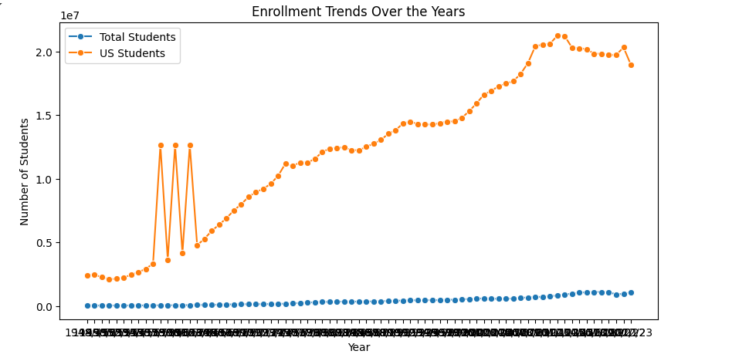
ENROLMENT TRENDS :
Significant US Student Growth:
US student enrollment surged dramatically post-1960s, driving the overall increase in student population.
Steady Overall Expansion:
Total student enrollment has consistently risen since 1948, reflecting long-term growth in education access.

Slide 14
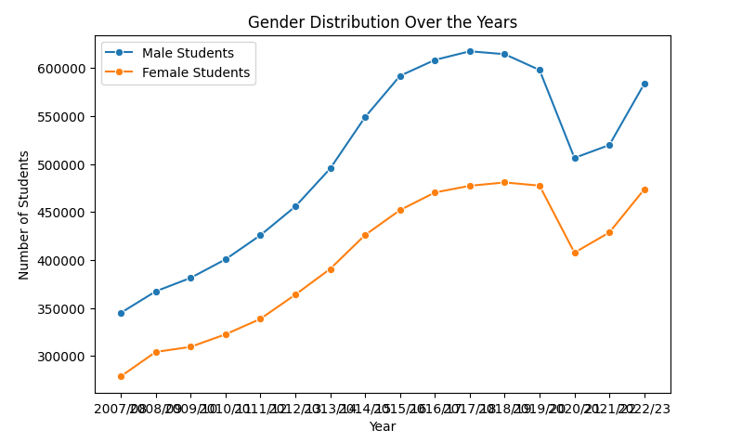
GENDER ENROLMENT TRENDS :
Consistent Male Dominance: Male student enrolment consistently surpasses female enrolment throughout the period.
Peak and Decline: Both male and female enrolments peaked around 2017/18, followed by a noticeable decline.
Recent Recovery: Enrolment for both genders shows signs of recovery in the most recent years.

Slide 15
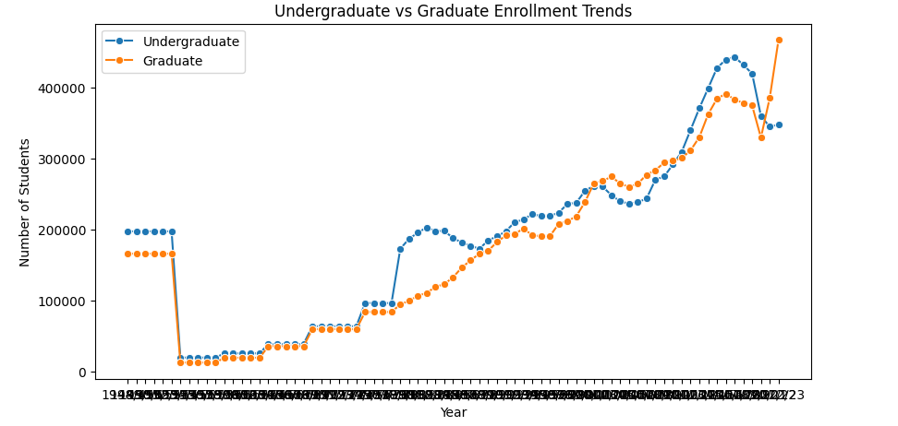
UNDERGRADUATE & GRADUATE ENROLMENT :
Parallel Growth: Both undergraduate and graduate enrolments show a generally parallel upward trend over the period.
Significant Drop & Recovery: Both categories experienced a sharp drop in the early 2000s, followed by a sustained recovery and growth.
Recent Peak & Fluctuation: Both reached a peak in recent years, with some fluctuation observed in the latest data.

Slide 16
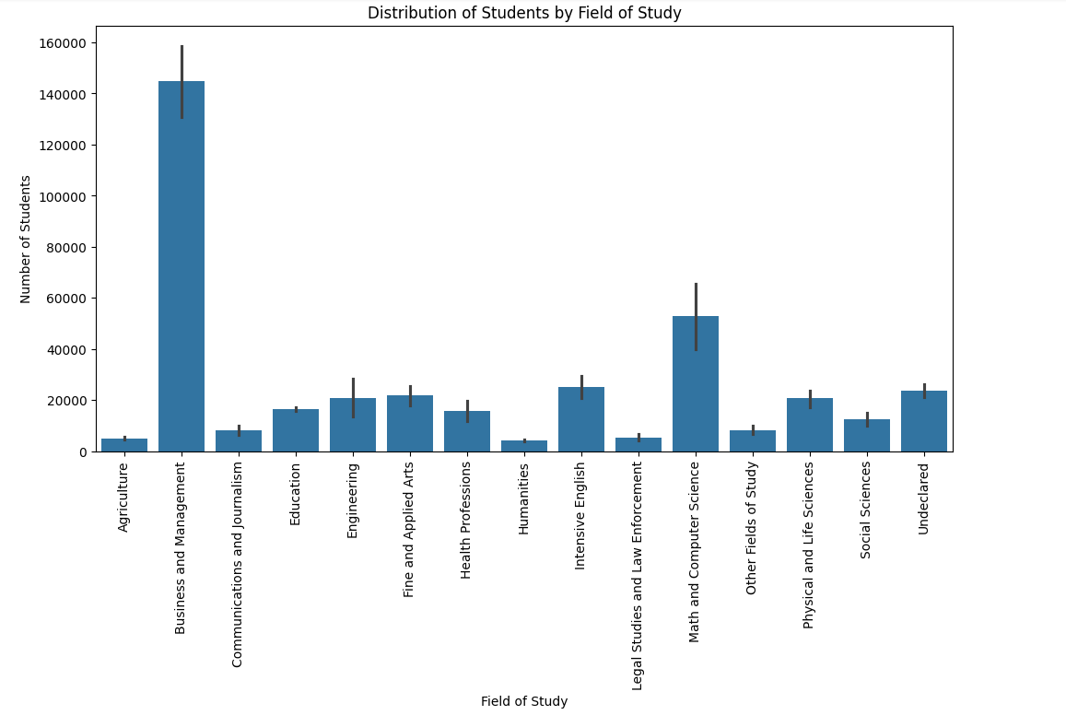
FIELD OF STUDY ENROLMENT :
Business and Management has the highest student enrollment by a significant margin, indicating its popularity among international students.
Math and Computer Science and Engineering also show strong enrollment numbers, reflecting demand for STEM-related disciplines.
Fields like Agriculture, Humanities, and Communications and Journalism have relatively lower student counts, suggesting niche or specialized interest.

Slide 17
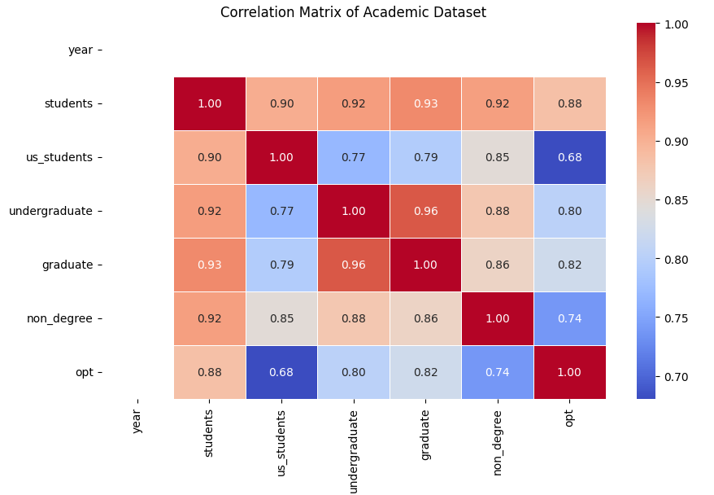
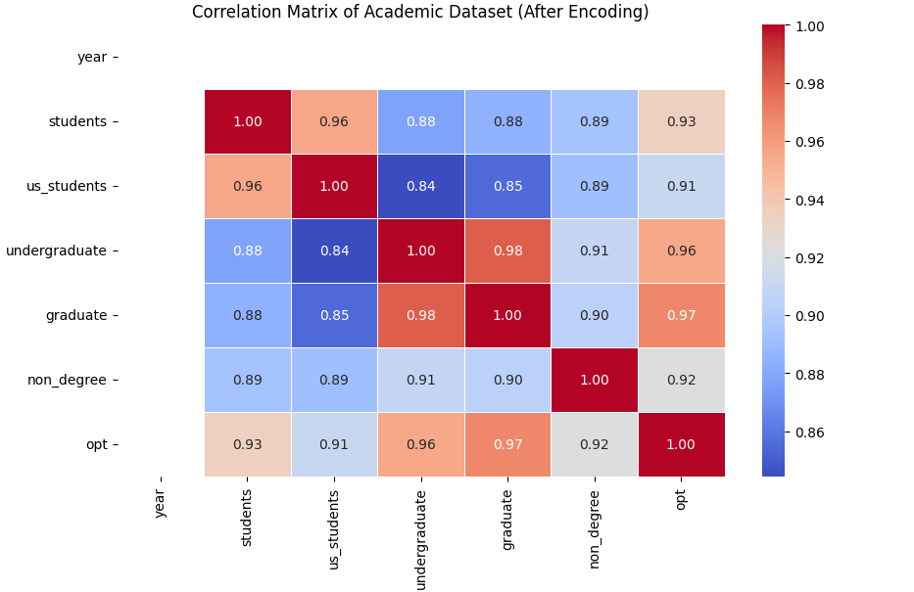
CORRELATION DYNAMICS: THE IMPACT OF DATA ENCODING

Slide 18
MODELS TESTED :
Random Forest – Baseline model for comparison.
Polynomial Regression – Regression-based approach.
XGBoost & CatBoost – Machine learning-based forecasting.
ARIMA – Time-series models capturing seasonal & trend components.

Slide 19
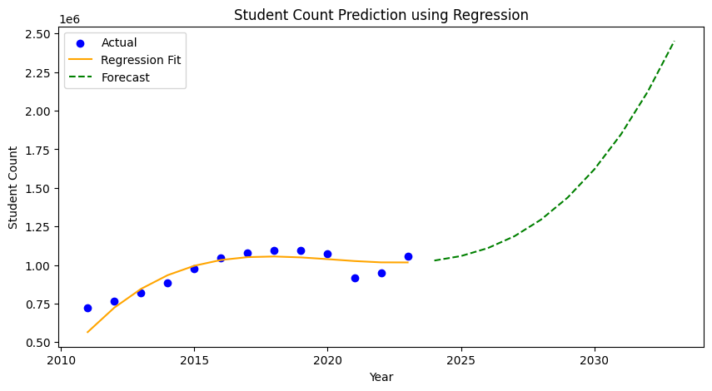
MODEL RESULTS : Random Forest & Polynomial Regression PERFORMANCE :
Random Forest Results :
Mean Absolute Error (MAE): 6259.04
R² Score: 0.8303
No forecast data generated.
Not suitable for long-term forecasting.
Polynomial Regression Results :
Training MAE: 41,133.15
Testing MAE: 88,058.07
Training R² Score: 0.8190
Testing R² Score: 0.5114
Overestimated future enrolment, leading to reduced accuracy.

Slide 20
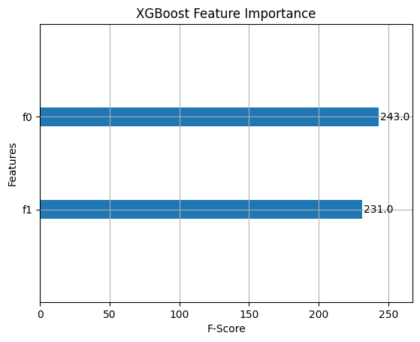
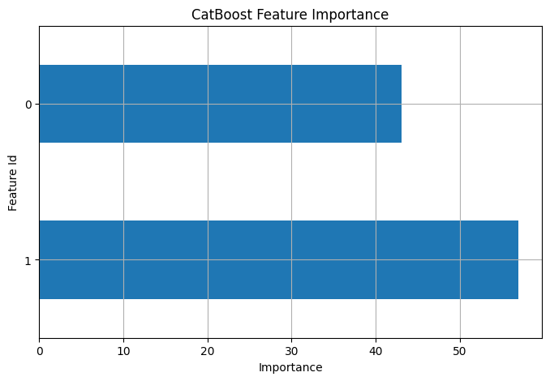
MODEL RESULTS : XGBoost & CatBoost PERFORMANCE :
XGBoost
CatBoost
MAE: 31,498.06
R² Score: 0.95
MAE: 30,029.70
R² Score: 0.94

Slide 21
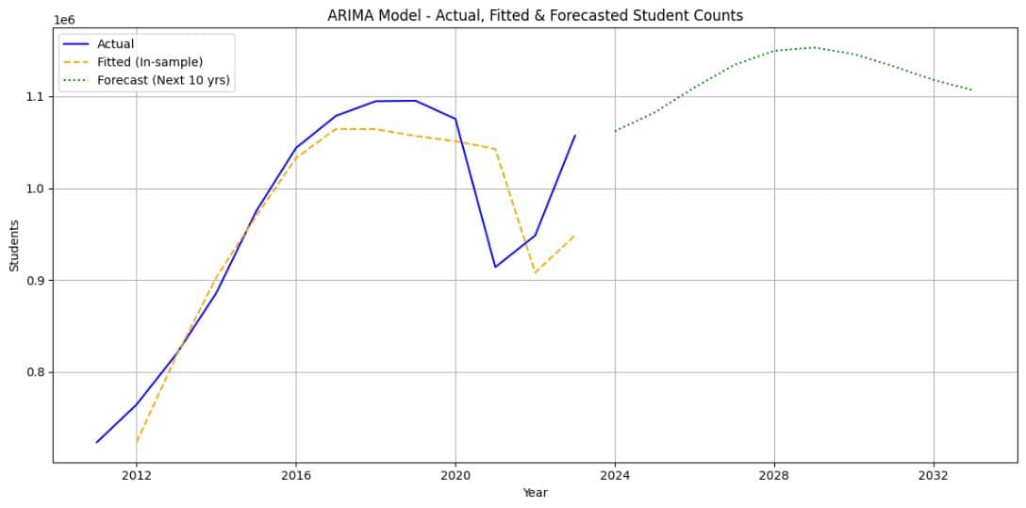
MODEL RESULTS : Arima PERFORMANCE :
ARIMA Model Forecast
In-Sample MAE: 38,395.77
In-Sample R² Score: 0.7513
Strengths:
Well-suited for time-series forecasting.
Captures long-term trends effectively.
Enhancements Over ARIMA:
Captures cyclical patterns in student enrolment.
More robust for long-term predictions.

Slide 22
MODEL COMPARISON REPORT :
Model | MAE | R² Score
Random Forest | 6,259.04 | 0.8303
Polynomial Regression | 88,058.07 | 0.5114
XGBoost | 31,498.06 | 0.95
CatBoost | 30,029.70 | 0.94
ARIMA | 38,395.77 | 0.7513
Final Selection: ARIMA , because of its ability to handle time-series dependencies effectively.

Slide 23
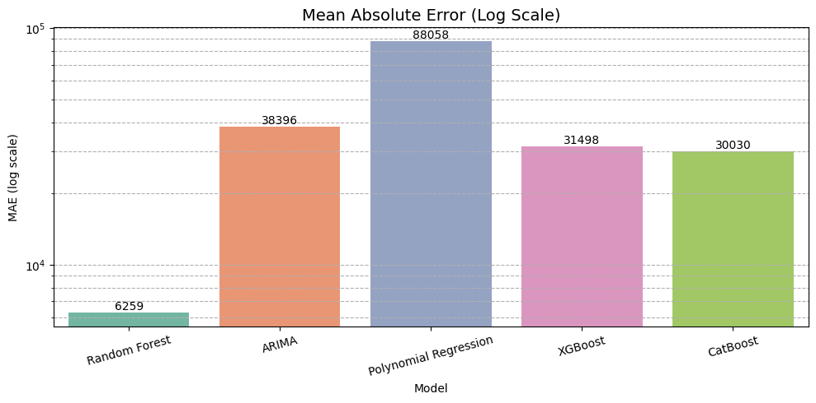
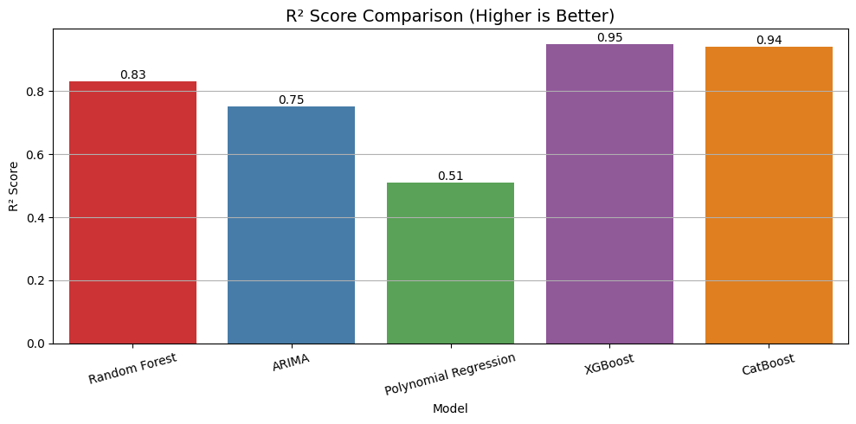
MODEL COMPARISON :
MEAN ABSOLUTE ERROR (MAE) COMPARISON :
R^2 SCORE COMPARISON :

Slide 24
POWER BI INTEGRATION :
Objective: Transform forecast data into interactive dashboards.
Steps Taken:
Integrated forecasted and historical student data into dynamic Power BI dashboards.
Enabled interactive filtering using slicers (year, academic type, region, etc.).
Visualized ML model outputs to support data-driven insights.
Designed intuitive dashboards like Academic Overview, Forecast Trends, and Student Status.
Improved decision-making through clear, user-friendly visual storytelling.

Slide 25
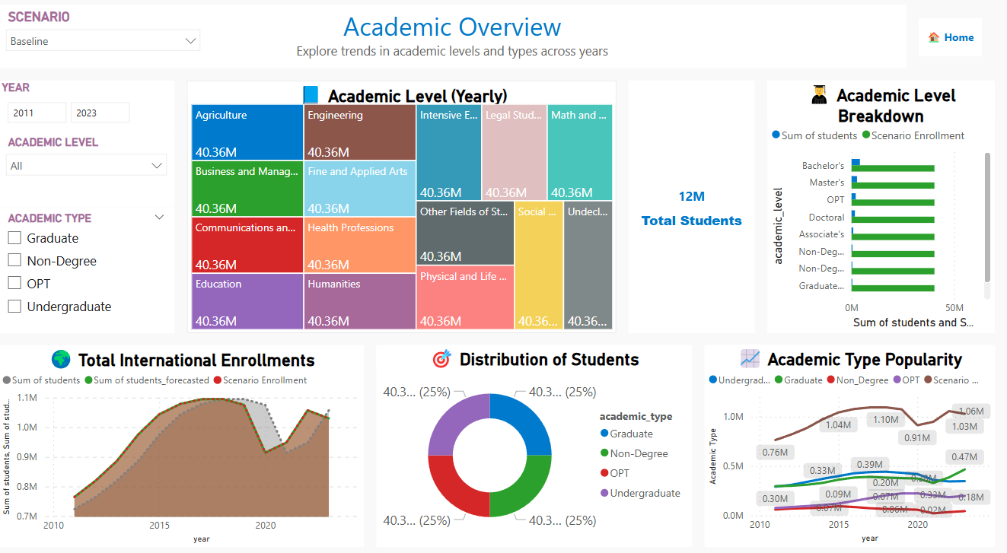
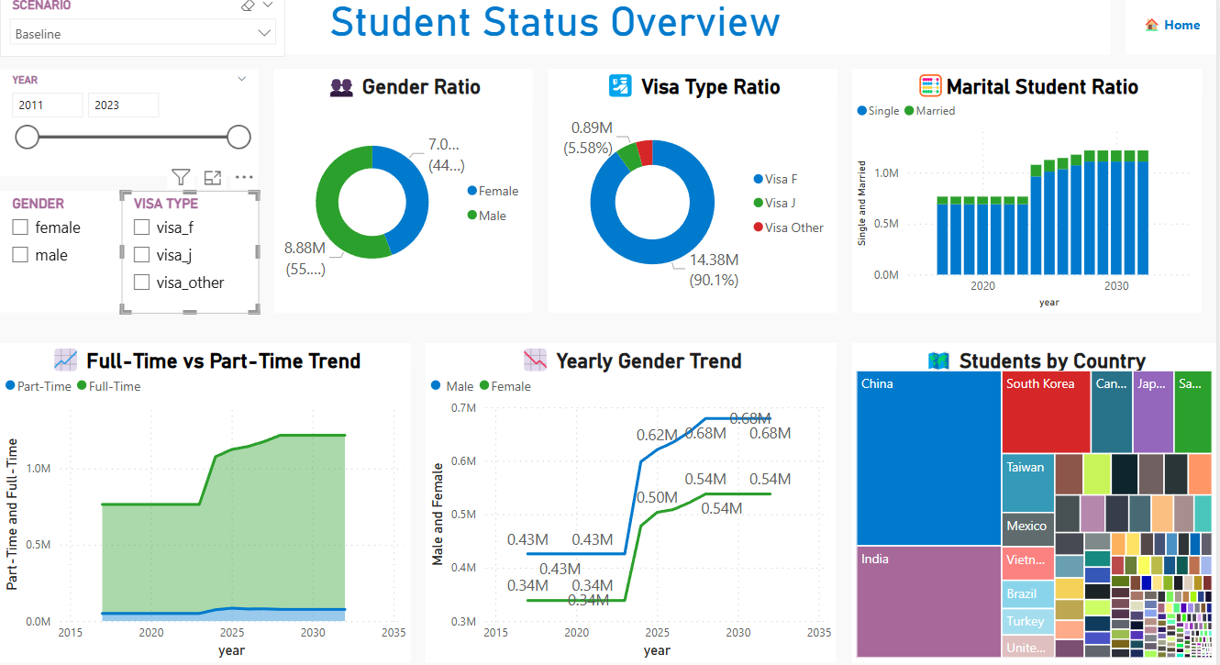
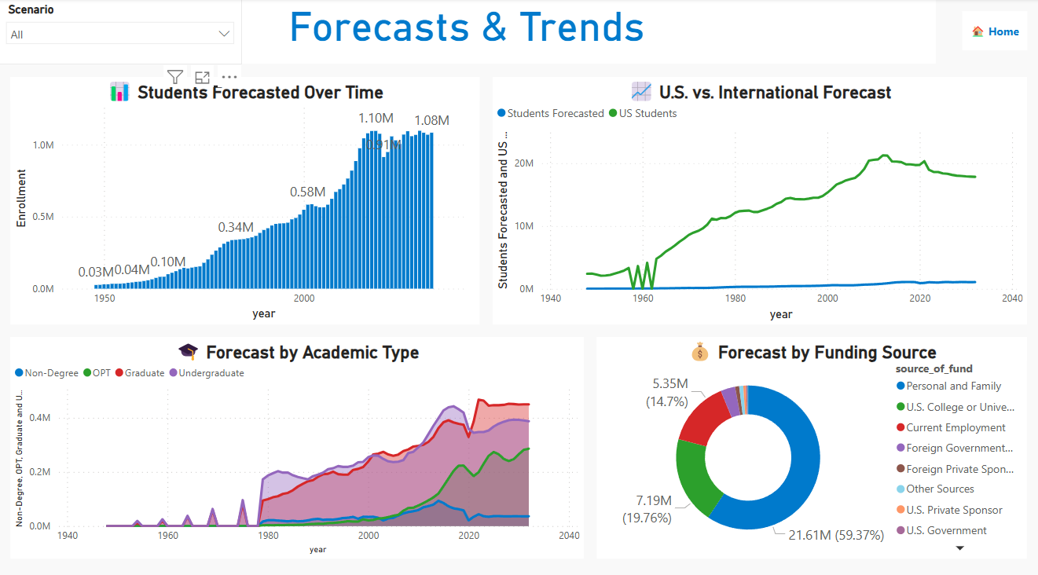
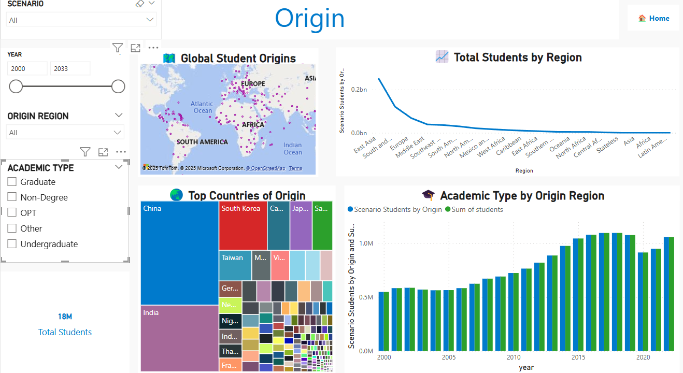
POWER BI DASHBOARDS :

Slide 26
FINAL M.V.P. (EduPredict Platform)
EduPredict is a dynamic platform designed to forecast international student enrollment trends using machine learning models.
Users can upload forecast CSV files directly through a simple "Upload & Explore" page to generate real-time summaries.
The home page showcases key insights like latest upload date, total forecasted students, and top contributing countries.
An interactive forecast preview graph allows users to instantly visualize enrollment trends after uploading data.
The platform is powered by SARIMAX forecasting, providing institutions with easy-to-use, insightful, and scalable enrollment predictions.

Slide 27
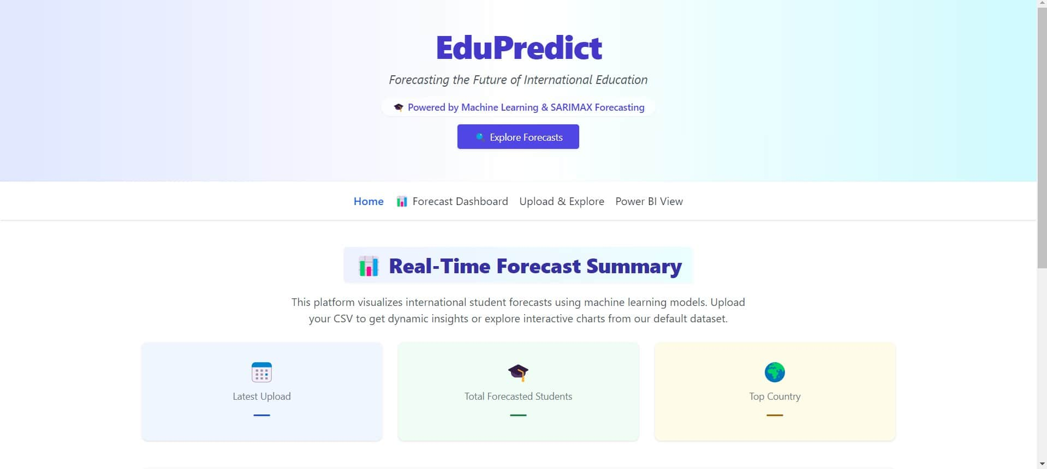
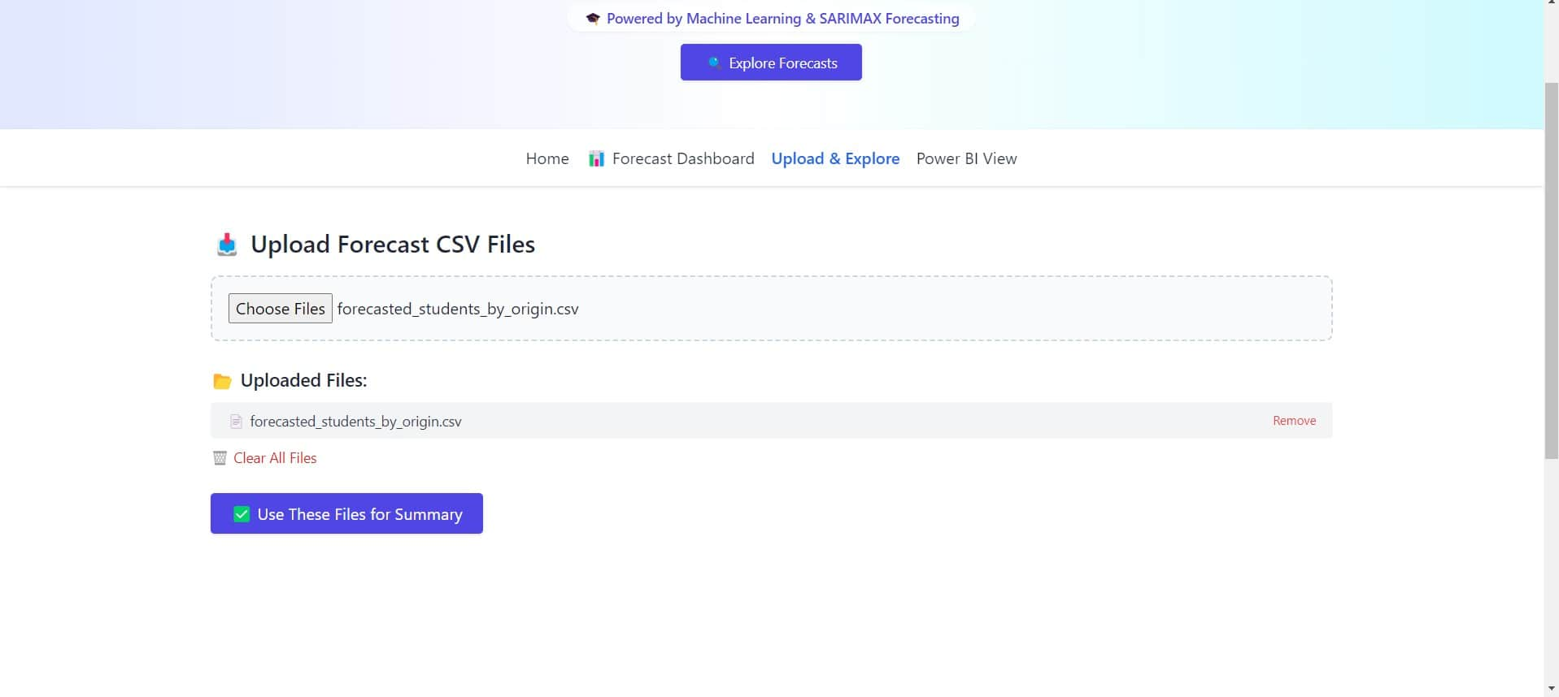
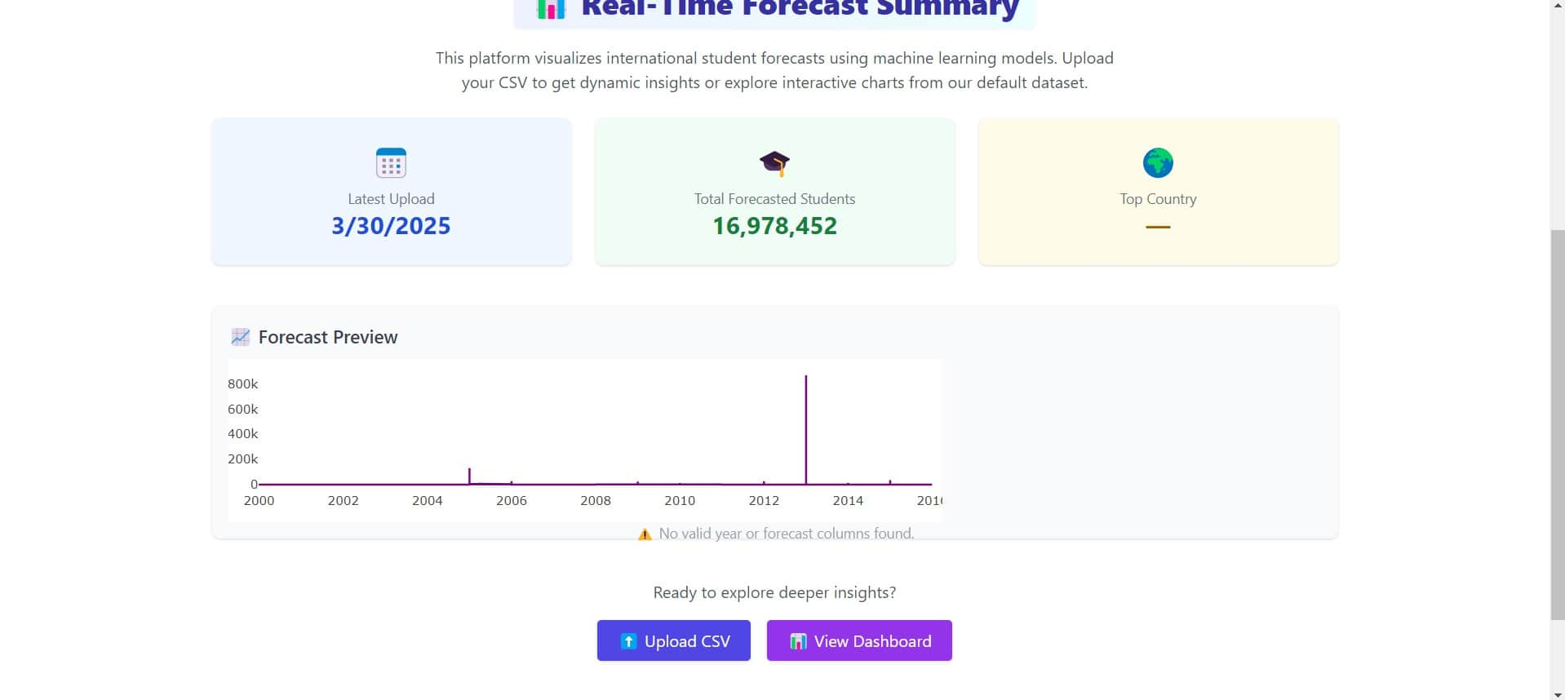
FINAL M.V.P.

Slide 28
TEAM MEMBER | CONTRIBUTION
PRIYANKA Data Engineer (Team Lead) | Led the overall project, managed timelines, and ensured data integration into Power BI. Supervised forecasting with ARIMA and delivered final presentation insights. Provided strong leadership in decision-making and guided the team across milestones.
SANTOSH Machine Learning Engineer | Developed and tuned forecasting models ( XGBoost, CatBoost), enhancing prediction accuracy. Assisted in model evaluation, integration into Power BI, and visualizing results effectively. Provided technical support for model optimization and hyperparameter tuning.
HARIKA Data Engineer | Processed and cleaned datasets, improving model consistency and performance. Prepared data transformations and supported the ML team with smooth pipeline integration. Contributed to PowerPoint summarization and resolved data issues during evaluation.
KRISHNA CHAITANYA Machine Learning Engineer | Explored and evaluated multiple forecasting models, optimizing ARIMA through hyperparameter tuning. Collaborated with data engineers to process training data and assess model performance with accuracy metrics. Supported presentation development by providing insights on model limitations and effectiveness.
SAI KRISHNA Data Analyst | Conducted exploratory data analysis (EDA) and provided statistical insights to support model selection and forecasting. Prepared comparative reports and assisted in feature engineering to improve model accuracy. Helped to interpret model outputs and contributed to final data-driven decisions.
TEJA REDDY Dashboard Developer | Designed interactive Power BI dashboards to visualize model results and insights clearly. Enhanced dashboard usability and interactivity for a better user experience. Collaborated with the team to align visualizations with project goals and stakeholder feedback.

Slide 29
THANK YOU
TEAM 02

